Slide 1
Multi-agent Coordination Under Temporal Logic Tasks and Team-Wise Intermittent Communication
Reporter: Zhang Shuo
2023.11.6

Slide 2
CONTENTS
01
Motivations & Challenges
02
Main Contributions
03
Thoughts

Slide 3
CONTENTS
01
Motivations & Challenges
02
Main Contributions
03
Thoughts

Slide 4
01 Motivations & Challenges
Multi-agent systems outperform single agent in complex collaborative tasks.
Coordination for multi-agent systems (MAS) with temporal logics is gaining attention, due to its intuitive framework to describe and coordinate complex tasks.
In large-scale scenarios, ensuring timely information exchange during decentralized task execution remains a challenge.
Existing approaches either assume fully-connected communication, or sacrifice task efficiency for communication.
All-time Communication usually neglect local tasks for agents, focusing solely on maintaining connectivity.
Intermittent Communication usually impose fixed communication schedules, or communication at predetermined locations

Slide 5
CONTENTS
01
Motivations & Challenges
02
Main Contributions
03
Thoughts

Slide 6
02 Main Contributions
the formulation of a novel task coordination problem under team-wise intermittent communication constraints;
the proposed online decentralized coordination scheme for task execution and team-wise communication

Slide 7


02 Main Contributions
a team of N robotic agents coexisting in a 2D workspace with a cluster of obstacles
Each agent can only traverse within the free space
employs the unicycle dynamics
Local Task Specification
All agents can navigate within the free space and perform various actions.
Communication Constraint
communication is constrained by the relative distance
communication network definition (time-varying edge set)
the team is required to maintain connectivity for at least Dc during each time interval Tc, known as the (Tc, Dc) constraint

Slide 8
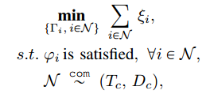
02 Main Contributions
Local Task Specification
Problem 1. Design an integrated planning scheme for agents to synthesis their complete plans Γi ,such that
local tasks and communication constraints are satisfied, meanwhile the sum of makespan is minimized.

Slide 9
02 Main Contributions
Integrated Planning of Local Task and Interminttent Commuication
Problem 1. Design an integrated planning scheme for agents to synthesis their complete plans Γi ,such that
local tasks and communication constraints are satisfied, meanwhile the sum of makespan is minimized.

Slide 10
03 研究方案
设计目的：设计成熟的海克斯棋小程序！
人机对战模式
人人对战模式
难度调节功能
……
程序可以实现人机对战模式，经自对弈数据训练后的程序，可以满足各个水平的选手需求
程序可以实现人人对战模型，使小程序满足朋友间下棋，高手对弈等需求
程序根据玩家的个性需求，可以主动或被动调节下棋水平，以满足各个棋艺水平选手的需求
开发更多功能完善小程序！

Slide 11
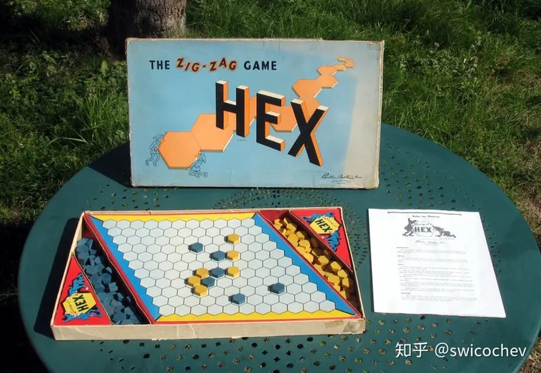
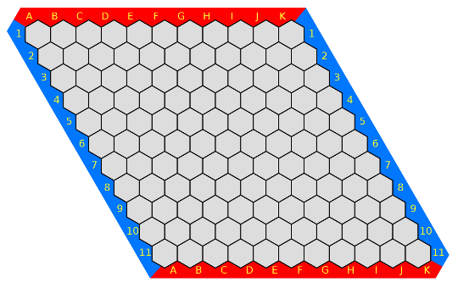
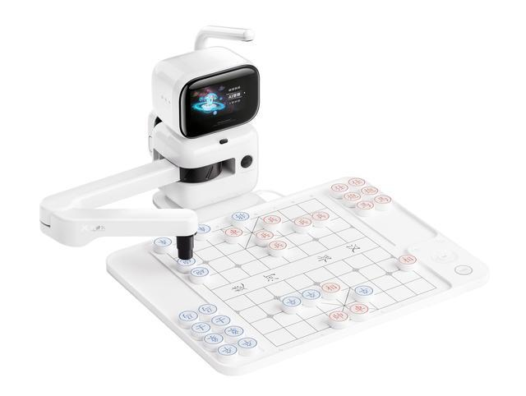
总 结与展望
下棋机器人——海克斯棋
人机对战
冷门棋种——海克斯棋
人人对战
难度选择
……
海克斯棋小程序
元萝卜AI下棋机器人（海克斯版）

Slide 12

衷心感谢各位聆听
恳请批评指正

